Slide 1
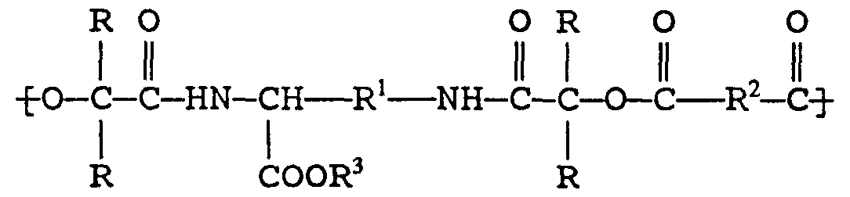
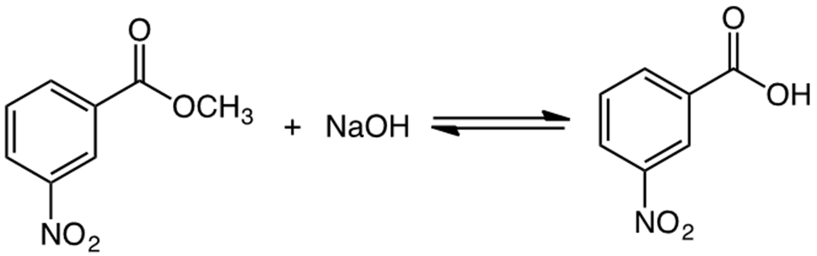
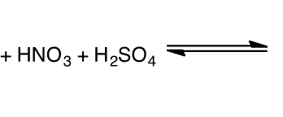
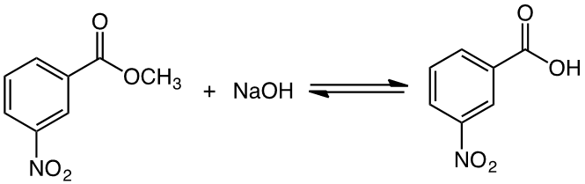
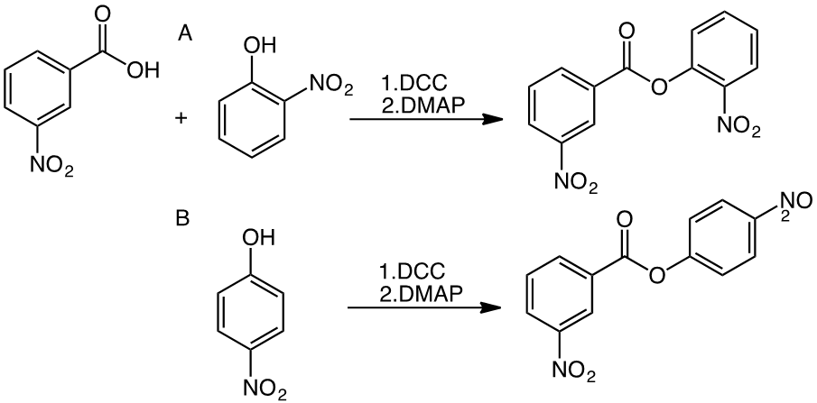
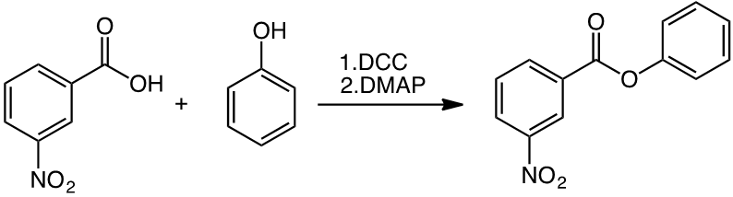
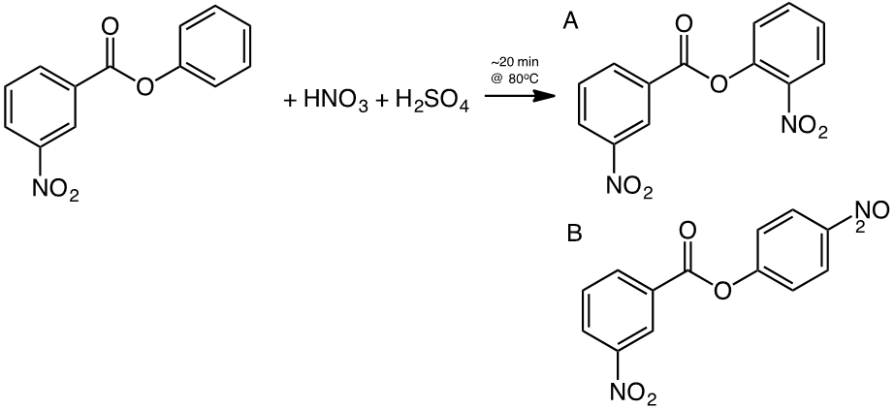
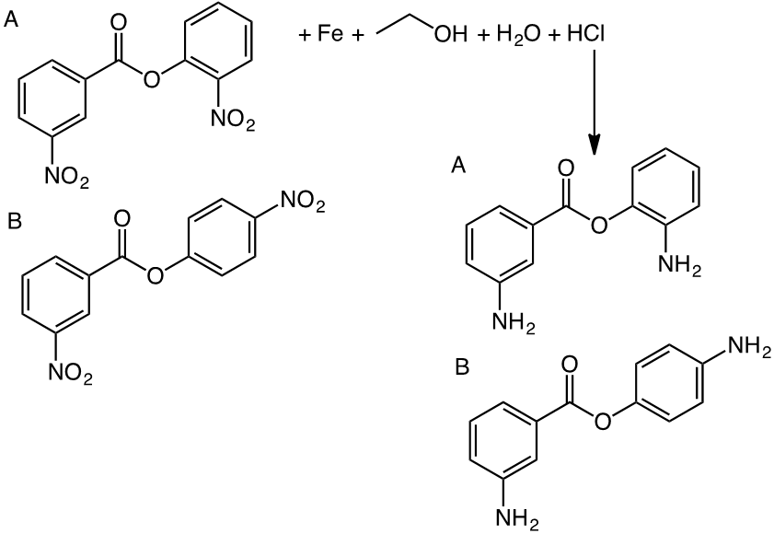
Synthesis of Polyester Amide Starting Materials
Lauren Butkus and Dr. Carolyn Weinreb
Saint Anselm College, Department of Chemistry, 100 Saint Anselm Drive, Manchester NH, 03102
Experimental
Methyl benzoate was nitrated to produce m-nitromethyl benzoate. The methyl group was hydrolyzed using NaOH, resulting in m-nitrobenzoic acid. This compound was then reacted with phenol in a DCC esterification which gave phenyl 3-nitrobenzoate.
The ester product is nitrated which yields both 2-nitrophenyl-3-nitrobenzoate (4.5%, crude) and 4-nitrophenyl-3-nitrobenzoate (35.5%, crude). For comparison of data, the dinitrated products were also formed by DCC esterification using m-nitrobenzoic acid and either ortho or para-nitrophenol. The ortho product yield was 2.821 mmol while the para product yield was 5.656 mmol.
The final reaction was the reduction of the nitro groups in the DCC reacted p-nitrophenyl-3-nitrobenzoate, giving the free amine product. The procedure used gave the product in a very small yield (>5% crude), and could not be purified as a result. H-NMR and mass spectra showed that reduction occurred, but C(13)-NMR was not able to be used to investigate if full reduction of the compound was successful. The remaining Fe in the sample interfered with the magnetic resonance, resulting in unclear peaks.
Basic structure of a polyester amide (2)
Abstract
Nitration and hydrolysis of methyl benzoate yields m-nitrobenzoic acid, while esterification through DCC coupling (Steiglich Esterification) gives phenyl 3-nitrobenzoate. As a result of electrophilic aromatic substitution, nitration of this product gives both 2-nitrophenyl-3-nitrobenzoate (4.5%, crude) and 4-nitrophenyl-3-nitrobenzoate (35.5%, crude). Additional DCC reactions were executed to form these compounds for comparison purposes (ortho, 28.2%; para, 56.6%). Initial analysis of the reduction of the nitro groups to the free amine looks promising. A mass spectrum of a TLC plate revealed the desired mass of the free amine product (228.2 g/mol). A ¹H-NMR spectrum also showed an amine peak, indicating that the nitrated compounds were successfully reduced.
Nitration
Steiglich Esterification
53.5%
91.6%
28.2%
2
Introduction
Polyester amides (PEAs) are promising materials for biomedical purposes, including tissue engineering, implants, and drug delivery. They have the potential for both hydrolytic and enzymatic degradation under physiological pH, and a variety of monomers can be chosen and integrated into the compound allowing for easy manipulation of properties. These characteristics enhance their applicability as biodegradable materials in the medical field. (1)
Understanding the electrophilic aromatic substitution of the methyl benzoate starting material and the phenyl benzoate based product was integral in predicting the orientation of the nitro groups after nitration. The first ring within the compound, attached to the carbonyl, is influenced by an electron withdrawing group, directing the nitro group to the meta position. The second ring, attached to the single bonded oxygen, is affected by an electron donating group which orients the nitro group in the ortho/para positions.
24.5%
56.6%
A. 4.5% (crude)
B. 35.5% (crude)
Discussion
The para position for the nitro group is favored and is more easily formed than the ortho product as shown in both yields for the nitration and DCC reactions. In the nitration, 35.5% of the yield was para, while only 4.5% was ortho. Equal amounts of starting materials and the same procedures were used in the DCC reactions, but the para product was produced in a greater quantity than the ortho product (5.656 mmol vs. 2.821 mmol). These results illustrate that the resonance of electron donating groups have a greater effect on ortho placement than para placement, leading to a higher yield of para-oriented product.
The free amine products represent the basic building blocks for polyester amides. Further experimentation of reduction methods is needed in order to give higher yields of these compounds. The next step in forming the PEAs would be to use the amine groups in linking specific monomers and more free amine products to lengthen the PEA chain.
2
B. >5% (crude)
Sources
1. Atkins, K. M.; Lopez, D.; Knight, D. K.; Mequanint, K.; Gillies, E. R. J. Polym. Sci. A Polym. Chem. Journal of Polymer Science Part A: Polymer Chemistry 2009, 47 (15), 3757–3772.
2. Roby, M. S.; Jiang, Y.; Zhang, G. Polyesteramide, its preparation and surgical devices fabricated therefrom, July 30, 1998.

